Slide 1

Final Project in Data 602
Intro To Data Analysis And Machine Learning
CARDIOVASCULAR HEALTH ESTIMATION PROGRAM
Group - 5
Harshini Akkapally - RK84133
Sai Gangadhar Veeramreddy - CS68859
Sai Manish Rao Sirikonda - BZ51019
Shaylee Fereidounfar - RQ67059
Under the guidance of Professor
Dr. Masoud Soroush

Slide 2

Introduction
According to WHO the cardiovascular disease (CVD’s) are leading cause of death penalty.
Around 17.9 million of people died from CVDs in 2019. Of these deaths, 85% were due to the heart attack and stroke.
CVD’s death has been more taken place in low- and middle-income countries.
There are some common behavioral risk factor such as tobacco use, unhealthy diet and obesity, physical inactivity and high usage of alcohol.
It is important to detect cardiovascular diseases as early as possible so that management with counselling and medication can begin.

Slide 3

Problem Statement
The main goal of this project is an estimation of the risks of heart attacks for new members of the medical process society.
So, we can generate and add these factors according to the dataset features by our own data and check the accuracy of our model.

Slide 4
About Data
Centers for Disease Control and Prevention publish annual surveys data through a system called Behavioral Risk Factor Surveillance System.
We have taken the 2020 dataset, the data set has around 401,958 records.
The dataset includes gender, age, and clinical test of the patient related to CVD.

Slide 5
Important Factors for CVD
Two categories of Risk Factors
Major Risk Factors: It has been proven to increase your risk of heart disease.
Contributing Risk Factor: It can lead to an increase in the risk of heart disease.
Major Risk Factors are High Blood Pressure, Diabetes, Obesity and Overweight, Smoking, Physical Inactivity, Gender, Heredity, etc.
Contributing Risk Factors are Stress, Sex hormones, Birth Control Pills, Alcohol

Slide 6

Important Features in the dataset
According to the Texas Heart Institute, these are the relevant factors that lead to CVD.
Diabetes -> DIABETE4
Obesity and Overweight -> _RFBMI5
Smoking -> _SMOKER3
Physical Inactivity -> _TOTINDA
Gender -> SEXVAR
Heredity -> _IMPRACE
Age -> _AGE65YR
Alcohol -> DRNKANY5
Coronary Heart Disease -> CVDCRHD4
Stroke -> CVDSTRK3
Heart Attack -> CVDINFR4
Out of 279 surveyed features, we have taken relevant features after the research.

Slide 7
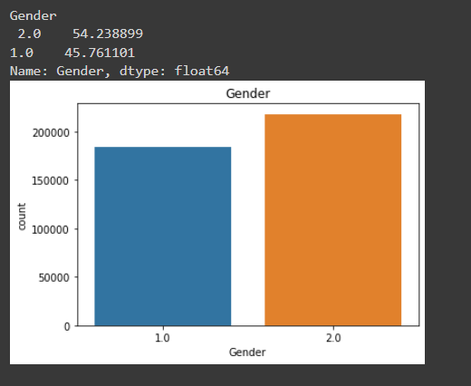
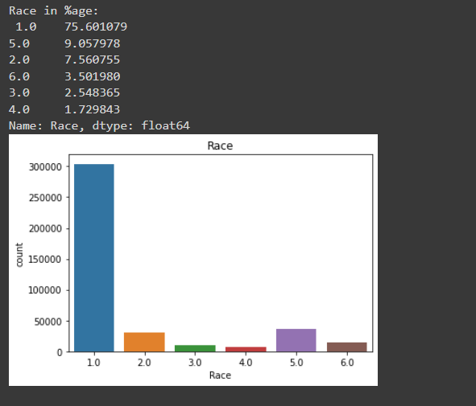
DATA ANALYSIS AND CLEANING
GENDER
There are 54 % females and around 46% males in the dataset.
The data is almost unbiased on the gender aspect.
RACE
Most prominent race in the data is White around 75%.
The second most is the Hispanic community.
This makes sense as most of the people in the US are white.
To add, Race is just a minor factor in CVD disease.

Slide 8
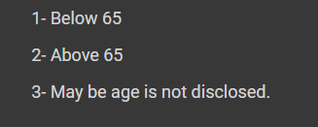
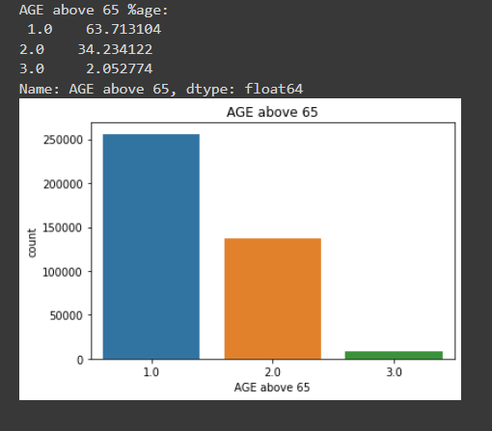
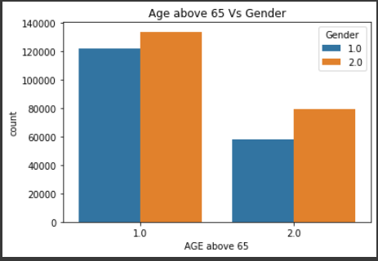
DA and Cleaning Continue…
AGE above 65
Around 64% of the population in data is below 65 years,34% is above 65, and the remaining 2% is unknown values, which we removed.
If we consider gender with age, we have more females both above and below 65.

Slide 9
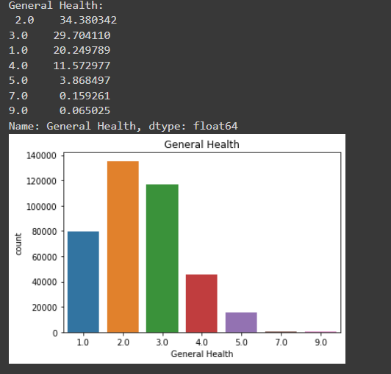
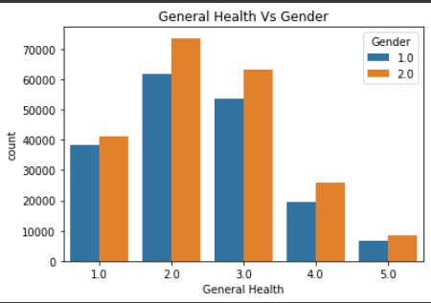
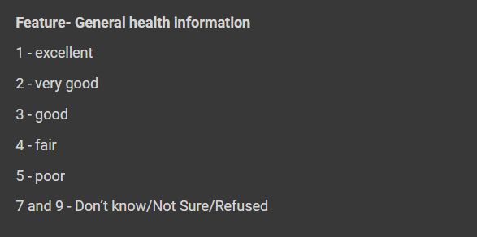
DA and Cleaning Continue…
General Health
34% of the data comes under the category of “Very Good” status followed by 29% under “Good” status. 7 and 9 % are not sure or refused values which we removed for our data.
If we consider gender with general health, females are dominant in all the status of health conditions.

Slide 10
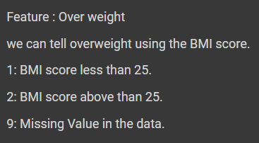
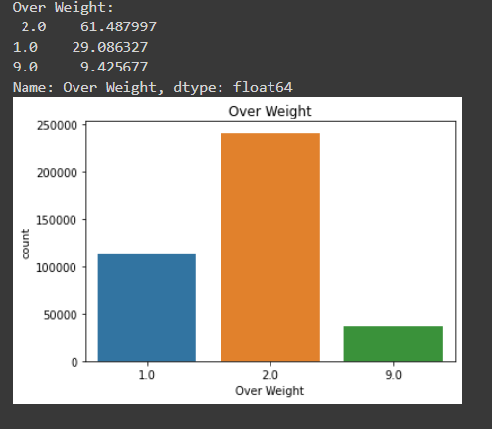
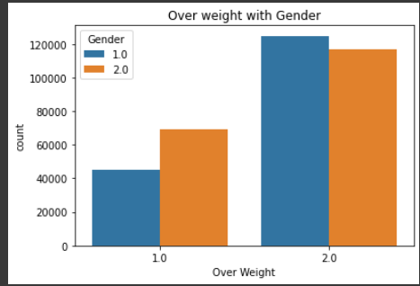
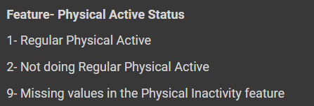
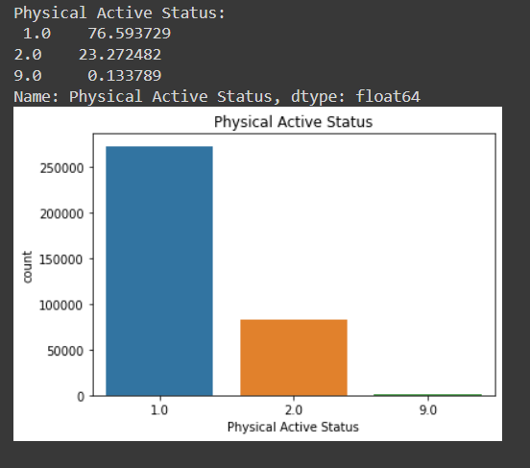
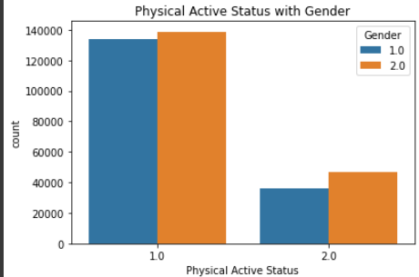
DA and Cleaning Continue…
Similarly, we have done the same analysis for other features and removed unwanted categories, here are some snapshots of it.

Slide 11
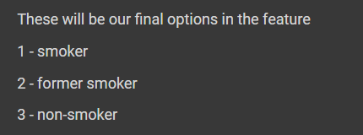
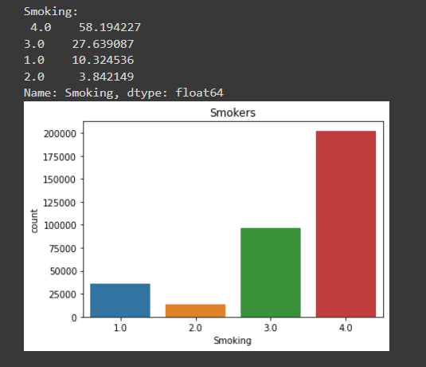
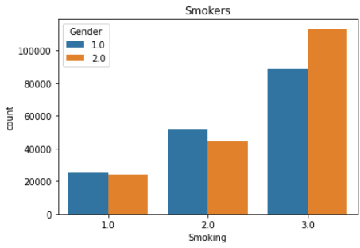
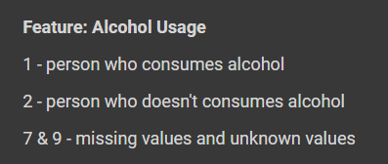
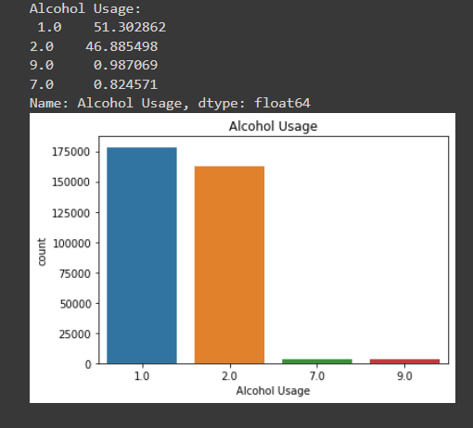
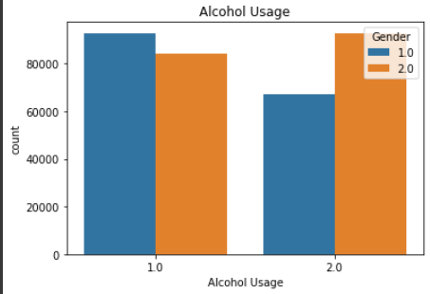
DA and Cleaning Continue…

Slide 12
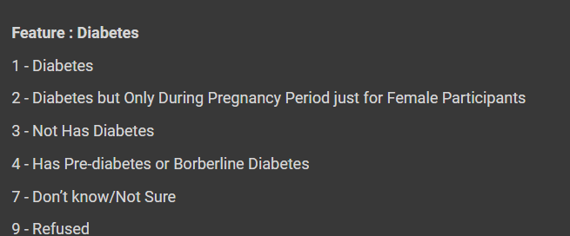
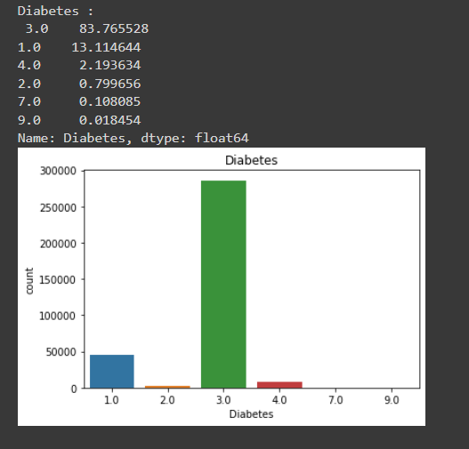
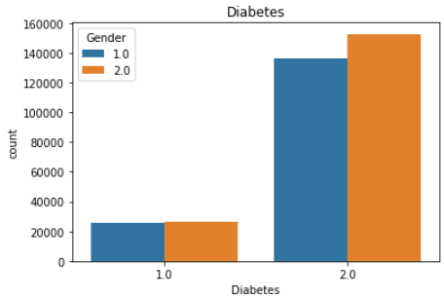
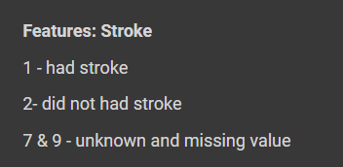
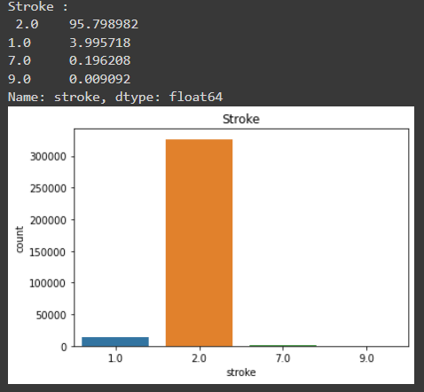
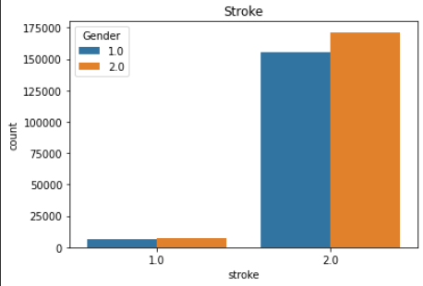
DA and Cleaning Continue…

Slide 13
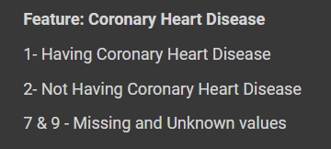
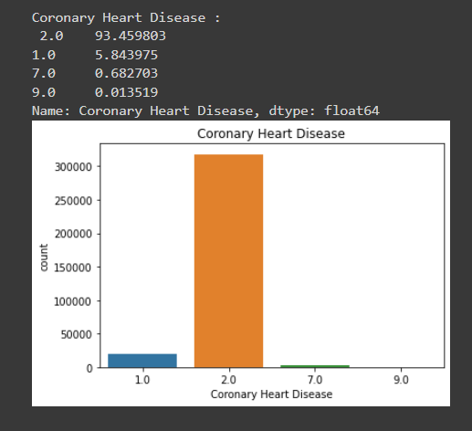
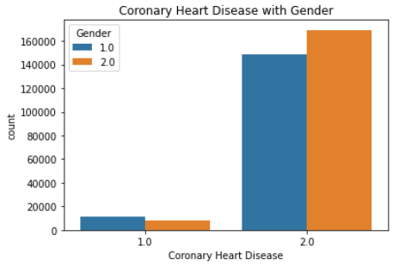
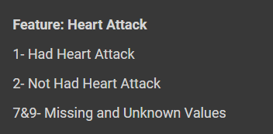
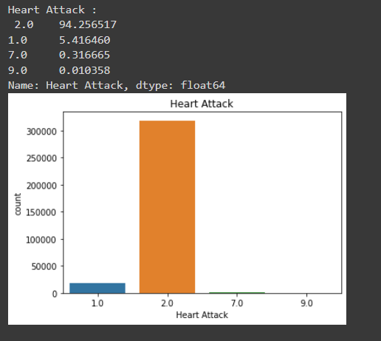
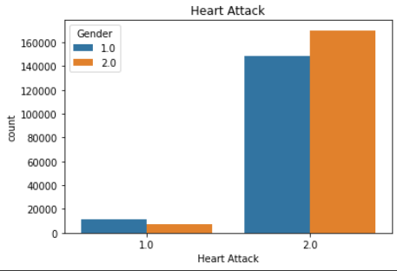
DA and Cleaning Continue…

Slide 14

Model Experimentation
We up sample the data and made the minor category balance with the major category train/test and split the data into 75:25 ratio
For better performance of the model, we have taken the top 4 features in the dataset
We have 1 Unsupervised Learning
K-Means Clustering
We have trained on 5 Supervised models on the data
Logistic Regression
K- Nearest Neighbor
Random Forest
XG Boost
ADA Boost
We have trained one neural network model for multi-label classification

Slide 15
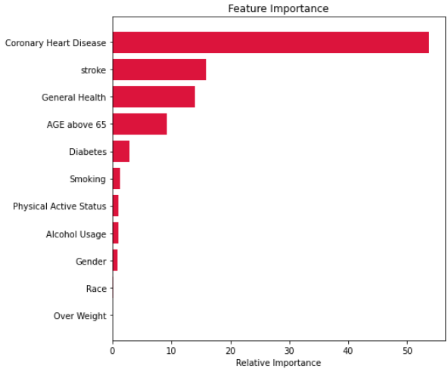
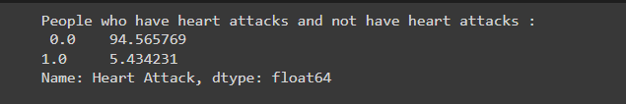
Baseline Model: Random Forest
Data is highly imbalanced.
Our target variable was Heart Attack. It has binary categories 0 (Not having heart attacks and 1 having heart attacks).
We run a baseline model to find the important features in the dataset.
We can see, Coronary Heart Disease is 43% correlated with Heart Attack which makes sense too.

Slide 16
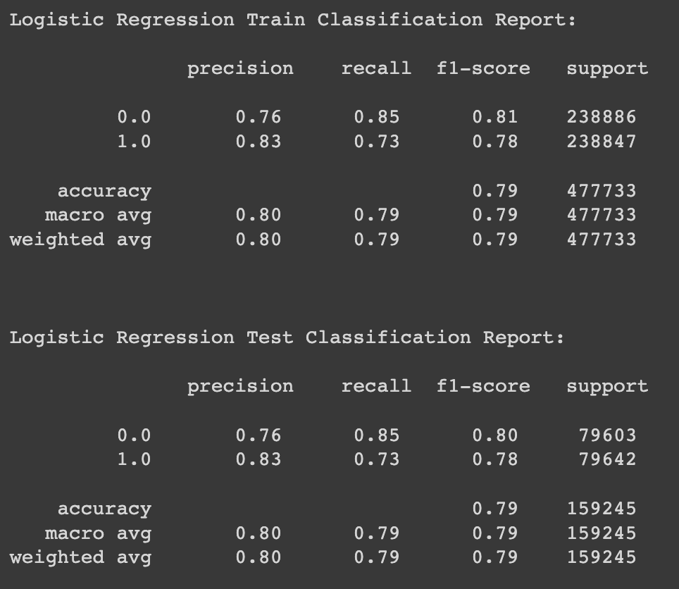
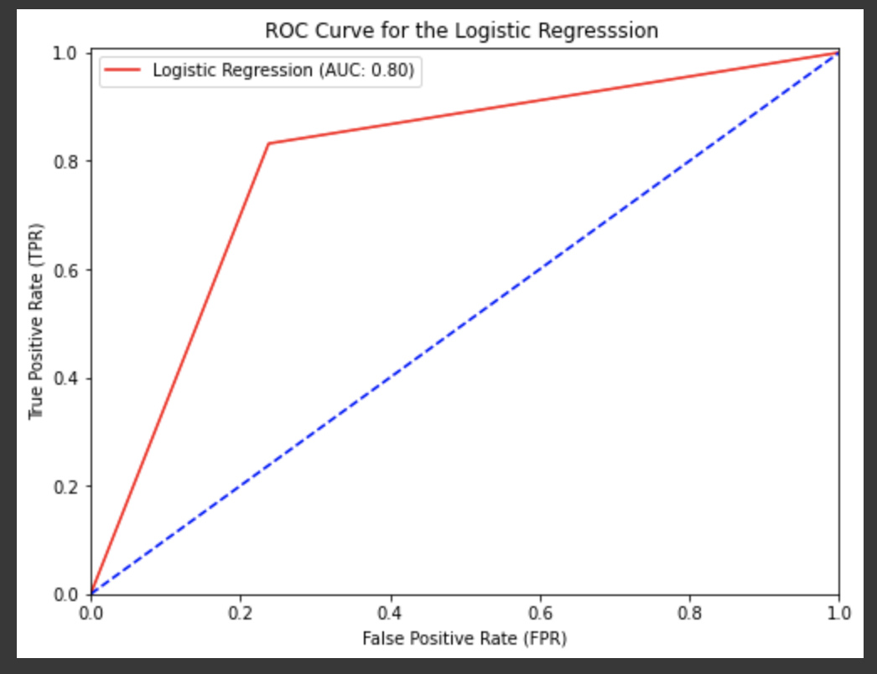
Logistic Regression
We don’t have a linear relationship between variables, so we have chosen Logistic Regression over Linear Regression
As our data is binary, we have chosen Logistic Regression
In our dataset, the data doesn’t have outliers hence it was prominent to use logistic regression.

Slide 17
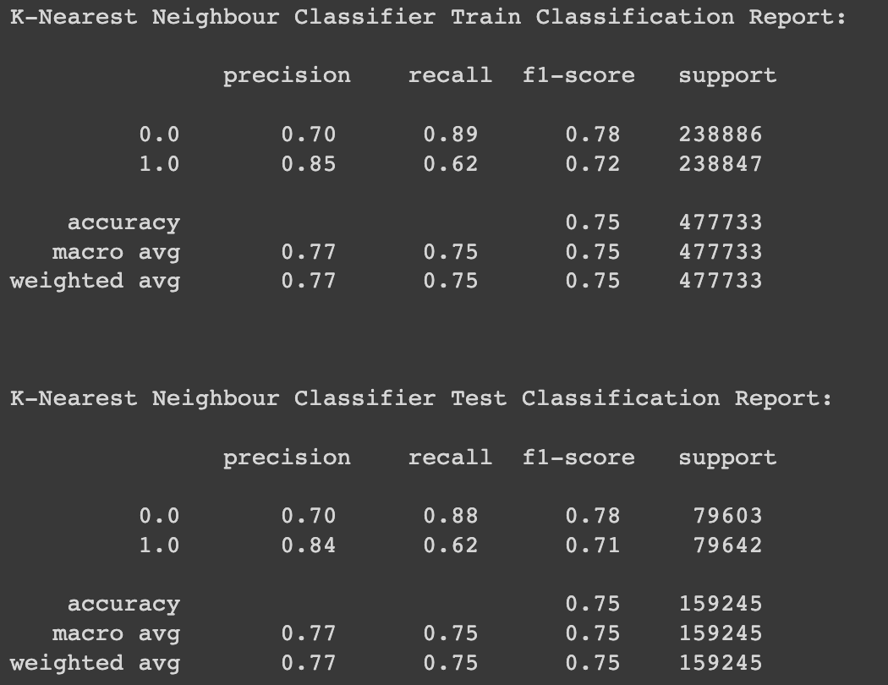
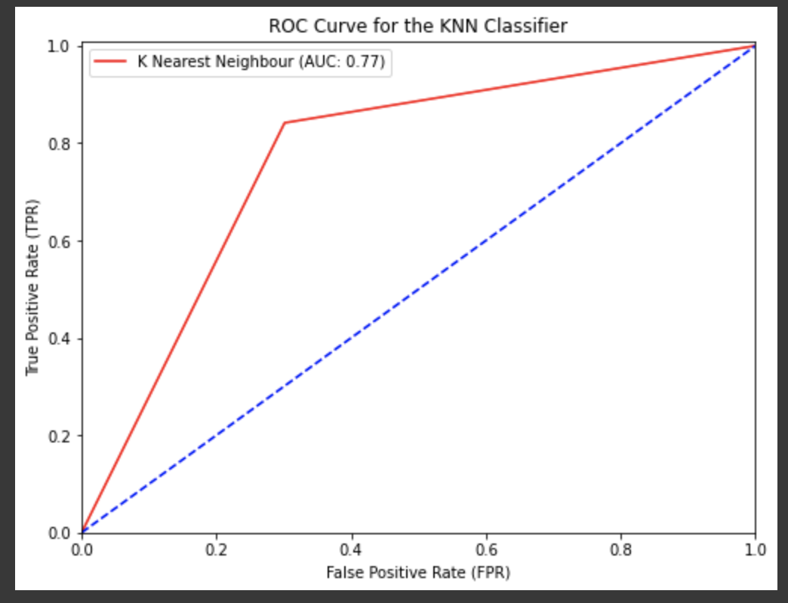
K-Nearest Neighbor
As we don’t have any knowledge of how the data is distributed and any parameters, KNN is the better choice
Train data is short and Test data is huge
The algorithm is easily adjustable with the data.
complexity of Training is o(1) and the complexity of test part is o(n).

Slide 18
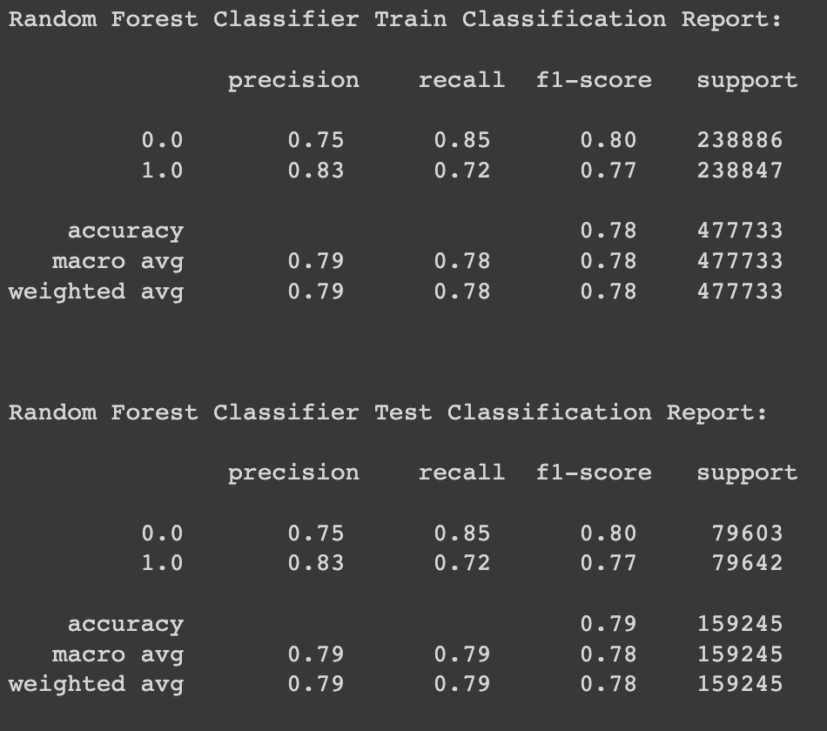
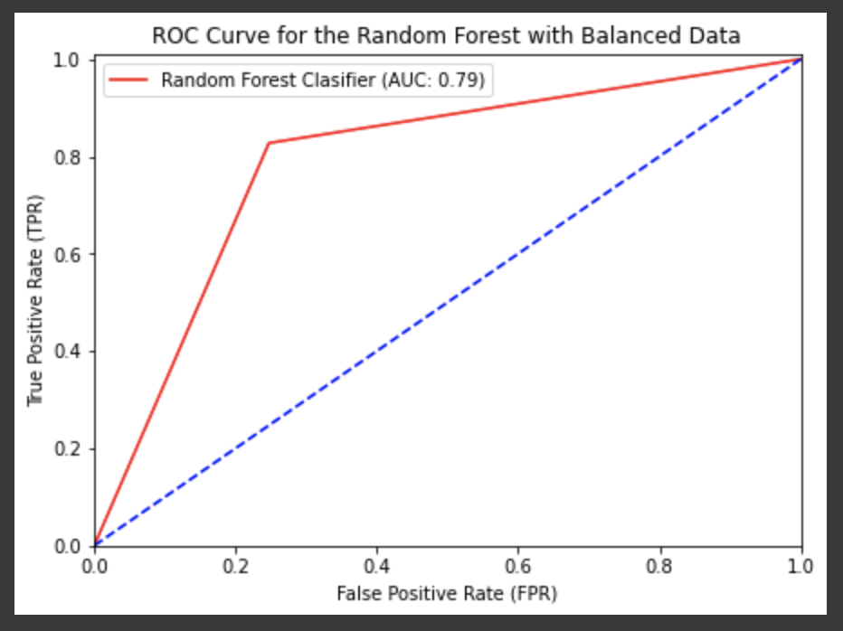
Random Forest Classifier with balance data
Random forest is very effective on a wide range of problems, but like bagging, performance of the standard algorithm is not great on imbalanced classification problem
We upsampled the minor class to balance the data
Random Forest Technique With the balanced dataset has the better accuracy which is 78%

Slide 19
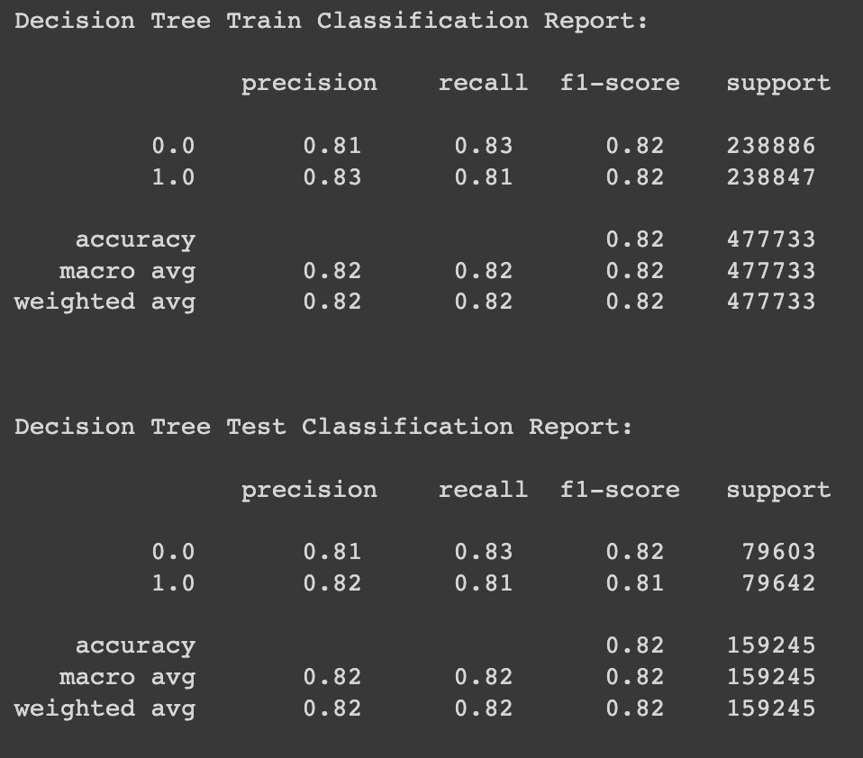
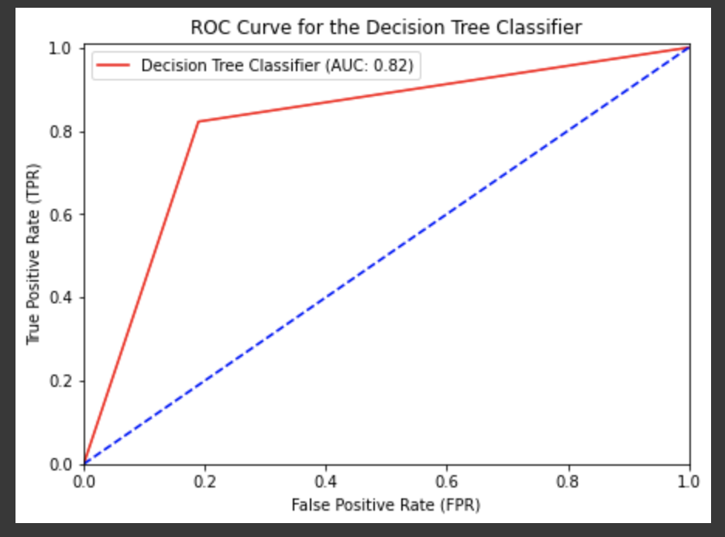
Decision Tree Classifier
Decision Tree Classifier is an All-Inclusive Algorithm.
Simple to Understand for Coders and are Inexpensive
Less likely to overfit
It requires less data preparation
It doesn’t need normalization of the data
Among all the algorithms we chose, it has the better accuracy which is 82% for both test and train data

Slide 20
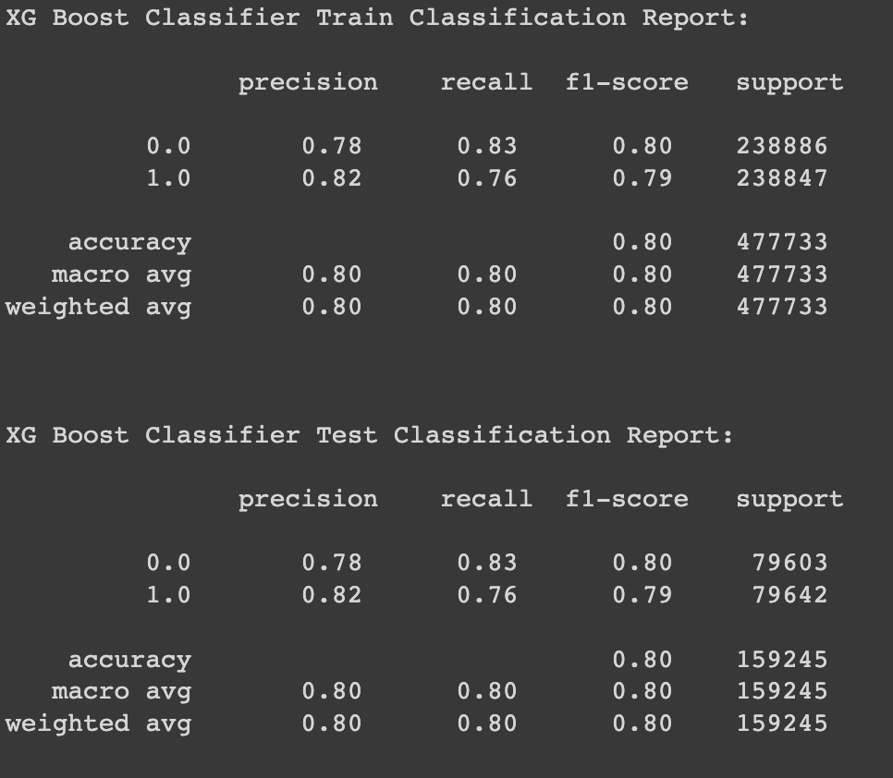
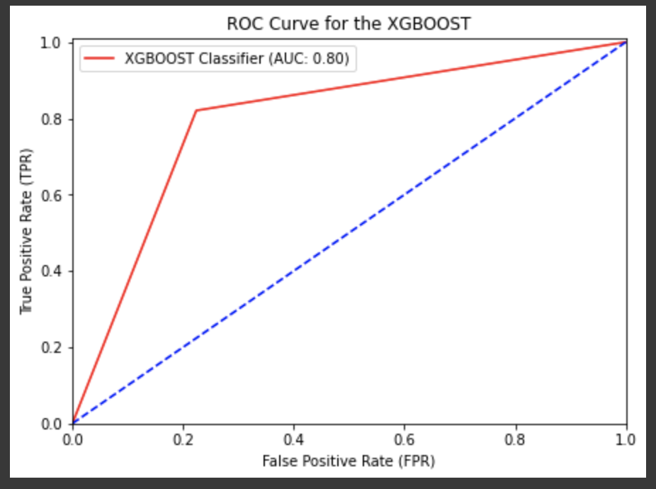
XG Boost Classifier
Ensemble Boosting Technique which is good for large datasets
XG Boost is a boosting technique that leverages sequence-built shallow decision trees
In case of noisy data, boosting models may overfit, but as we don’t have noise in the dataset, we tried XGBoost
We used XG Boost as it provide high accurate results and it has given an accuracy of 80% on both train and test data

Slide 21
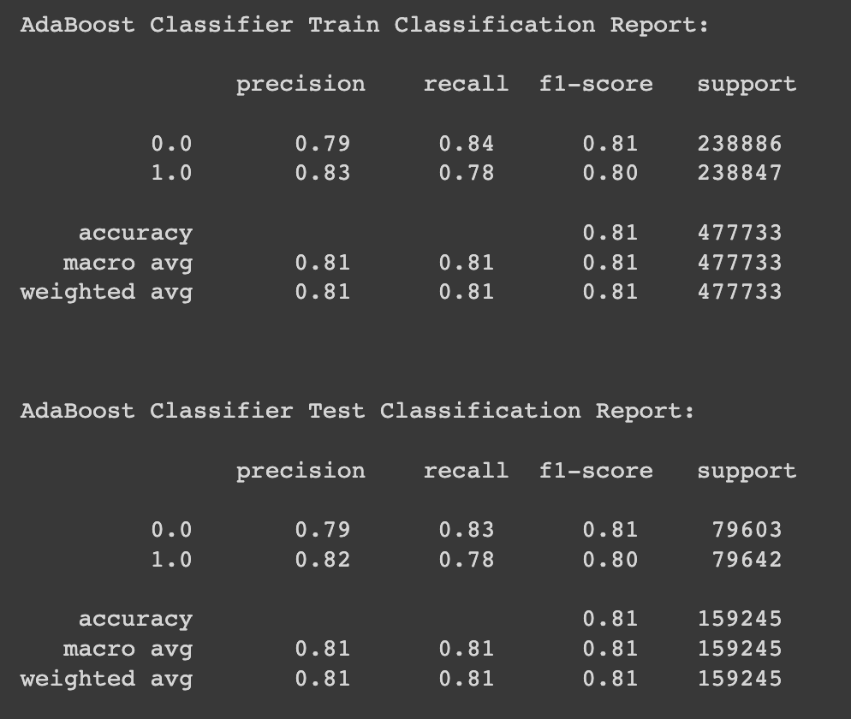
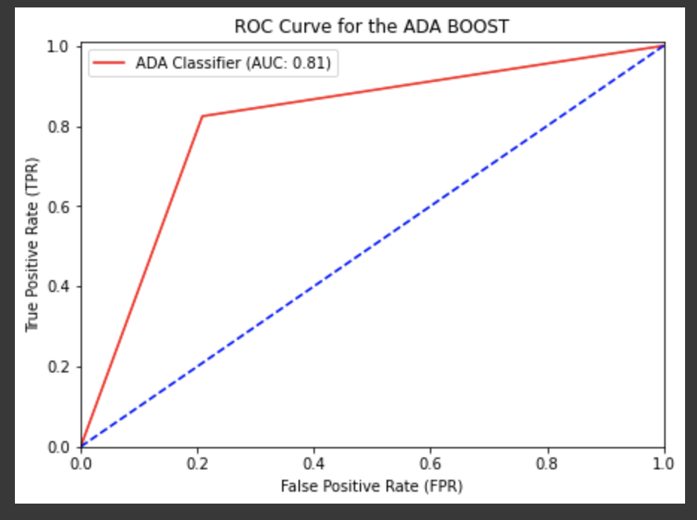
Adaboost Classifier
AdaBoost was the first really successful boosting algorithm developed for the purpose of binary classification.
It works by combining multiple “weak classifiers” into a single “strong classifier”.
It is now being used to classify text and images rather than binary classification problems
But it has given good accuracy of 81% on train and test data

Slide 22
Hyperparameter Tuning
Finding a set of optimal hyperparameter values for a learning algorithm
We used grid search for hyper parameter tuning
That combination of hyperparameters maximizes the model's performance
Minimize a predefined loss function to produce better results with fewer errors
As we can see the results, it worked better when compared to the simple models
Hyper parameter tuning increased the accuracy by 2 - 4%
Models | Train | Test
Random Forest Classifier | 0.78 | 0.79
XGBoost | 0.80 | 0.80
Random Forest Classifier (Tuned) | 0.82 | 0.81
XGBoost (Tuned) | 0.81 | 0.80

Slide 23
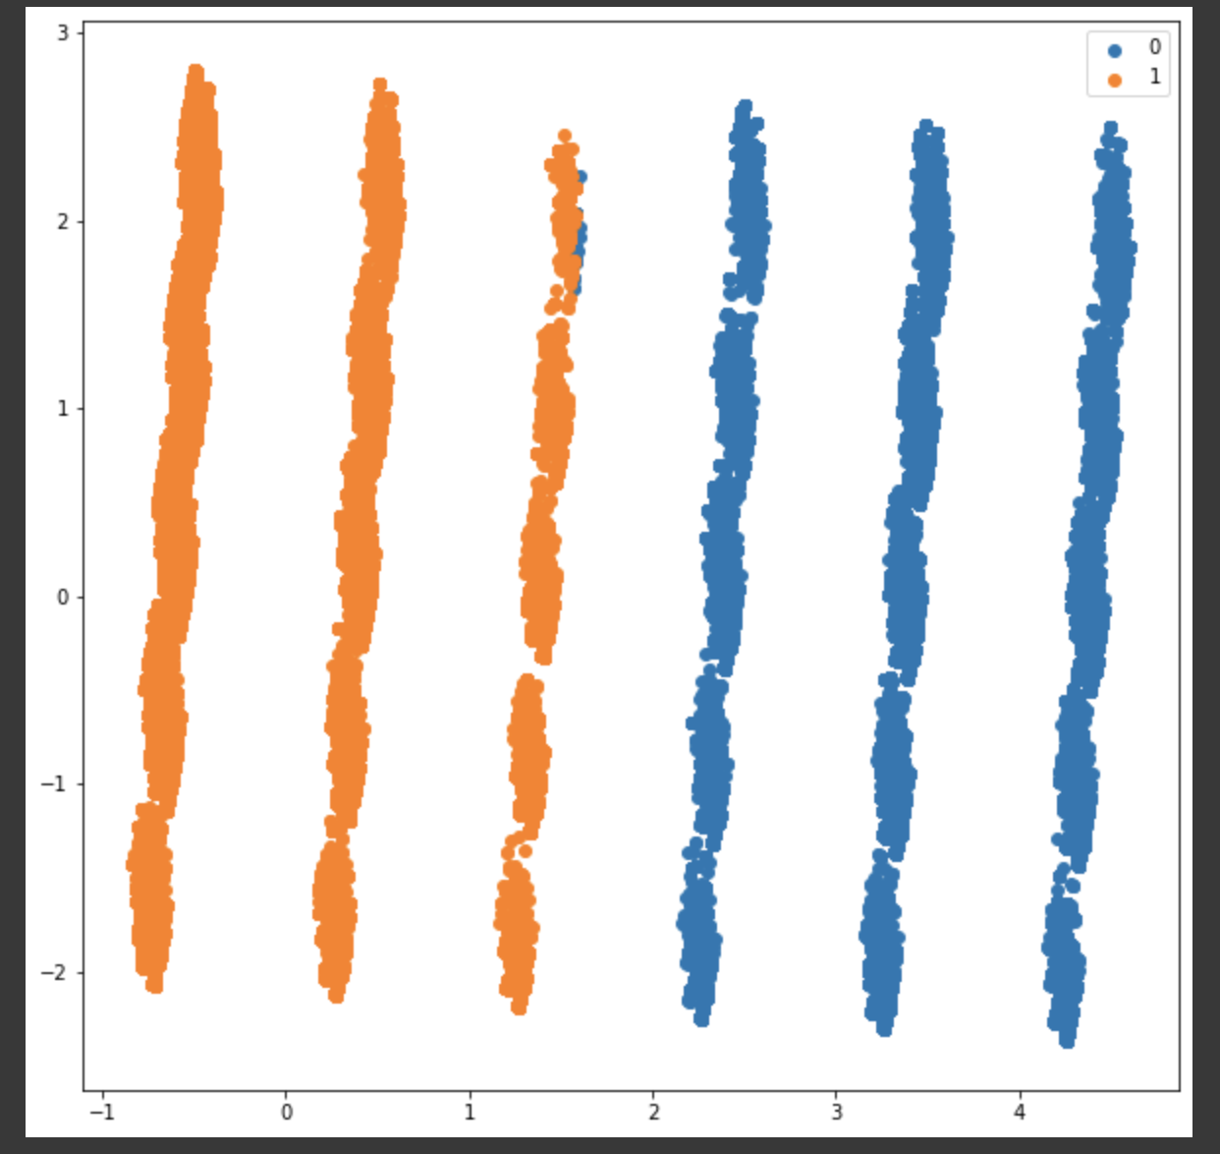
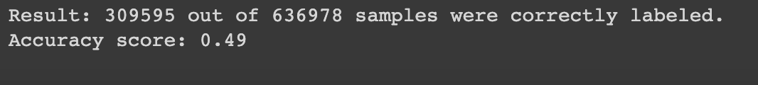
K Means Clustering
We tried to check the results by applying unsupervised technique to compare with supervised algorithms
K Means is a Clustering Algorithm
Not Preferable for Binary Classification Dataset
As we see the Results, Accuracy is low which is 49%
The accuracy increased to 51% after PCA (Principal Component Analysis)
K Means:
PCA:

Slide 24
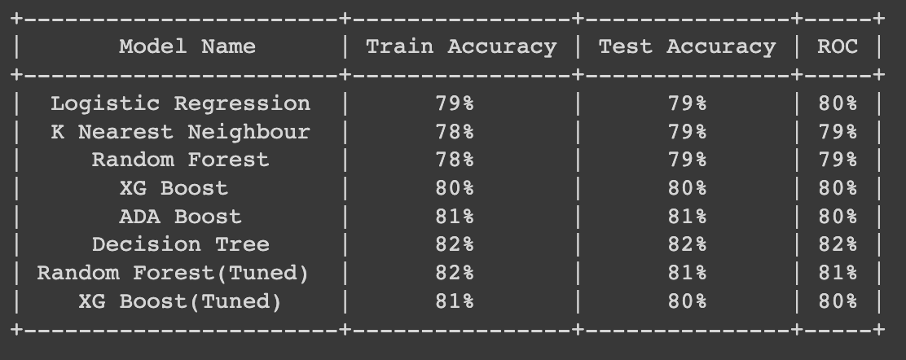
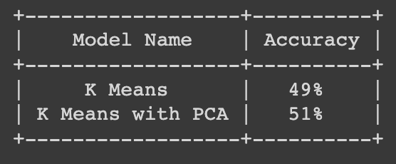
Model Evaluation
We made the data balance; hence accuracy can be an appropriate metric to choose.
Supervised Learning
Unsupervised Learning
Decision Tree performed well compared to other algorithms. After tuning Random Forest performed well, as it was 82% on the train and 81% on test data.
We can see dimensionality reduction technique (PCA) has significantly increased the accuracy.

Slide 25



Multi-Label Classification
We implemented a model on an imbalanced dataset
We have taken target variable as a 2d vector in the data which has 3 categories in it.
Our task was to find the probability of each category.
We created a multi layer perceptron , to find the probability using sigmoid as an activation function which gives the output between 0 and 1.

Slide 26



Neural Network Model Evaluation
Multi-layered Perceptron
Model Training
Model Results
We saved the best model after training which has least binary cross entropy.
We can find the probabilities of each category in a single target variable.

Slide 27



NN- Model Evaluation
We ran an evaluation model using k-fold cross-validation to validate the accuracy of the NN model.
We got a mean accuracy of 89%.

Slide 28

Conclusion
Predicting heart attacks by the historical data of a person, can help people to take precautions as soon as possible
Estimating the probabilities of three features that lead to heart attacks can help patients to understand the chances of heart disease
For this dataset, In Supervised algorithms, Decision tree Classifier performed well with 82% accuracy on training and test data.
Also, Random forest after tuned gave the best accuracy on the training at 82% and test data at 81%.
Neural Networks Multi Label Classification has given the best accuracy of 89%

Slide 29
Recommendations
To get the Better Results we can consider the below,
Manage Missing Values and Outliers in the Data
Feature Engineering
Cross Validation
Normalization

Slide 30
References
Brownlee. (2020, August 31). Multi-Label Classification with Deep Learning. https://machinelearningmastery.com/multi-label-classification-with-deep-learning/
Coronary artery disease - Symptoms and causes. (2022, May 25). Mayo Clinic. https://www.mayoclinic.org/diseases-conditions/coronary-artery-disease/symptoms-causes/syc-20350613
Hajar R (2017, September 18. Risk Factors for Coronary Artery Disease: Historical Perspectives. Heart Views: 109-114. doi: 10.4103/HEARTVIEWS.HEARTVIEWS_106_17. PMID: 29184622; PMCID: PMC5686931.
The Texas Heart Institute. (2020, October 1). Heart Information Center: Heart Disease Risk Factors | Texas Heart Institute. https://www.texasheart.org/heart-health/heart-information-center/topics/heart-disease-risk-factors/

Slide 31


